Slide 1
Charity Foundation Platform System
By: Group_Zeta
Jinning Yang
Jiaoli Yang
Hanzhang Wang

Slide 2
Content:
01
Background
02
How it works
03
Key Screenshot

Slide 3
P
1
art
Background

Slide 4

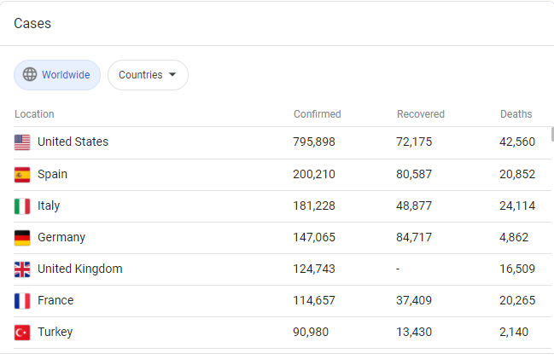
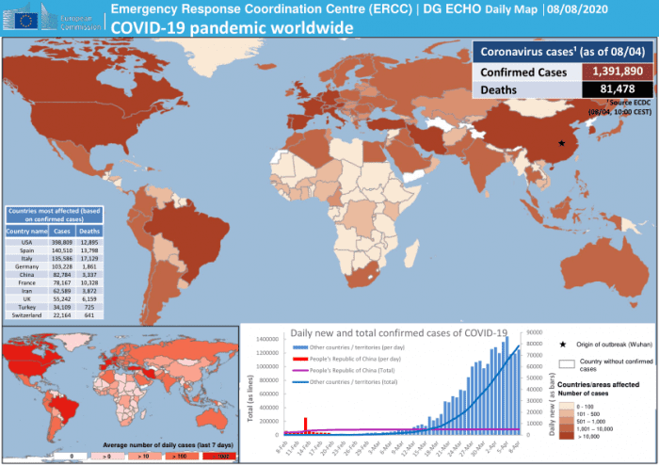
Background
The whole earth is now suffered by COVID-19. Many hospitals are short of all kind of resources like masks, goggles even voluntary nurses.

Slide 5
Background
People are willing to give out money or supplies but they don’t know whether their money or supplies can be delivered to the right hand.
The World is snatching resources between hospitals, cities and even countries.
In such a case, a well-developed and efficient charity foundation platform is indispensable.
So we developed the:
Charity Foundation Platform System

Slide 6


System Goal:
Solve doctors' needs quickly and save their time
Transmit resources efficiently in chronological order.
Collect evaluations and make progress

Slide 7
P
2
art
How it works

Slide 8
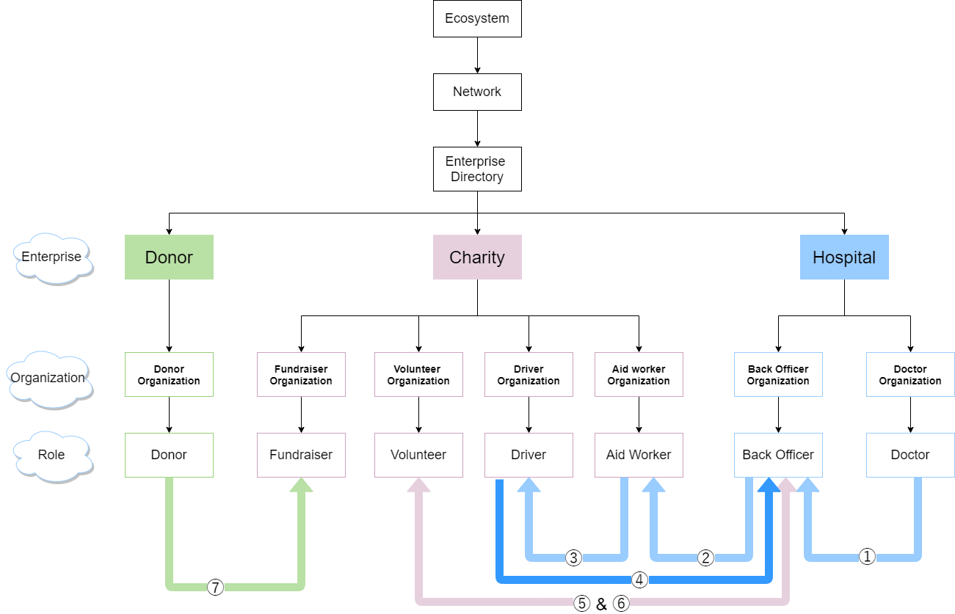
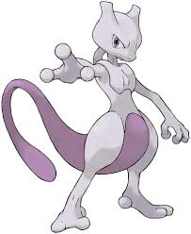






Object model

Slide 9
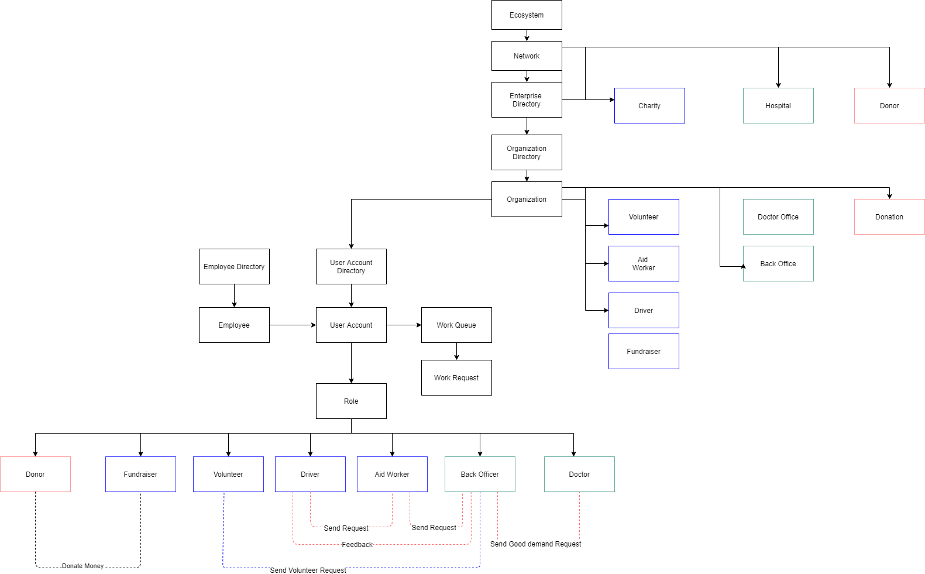
Architecture Diagram

Slide 10
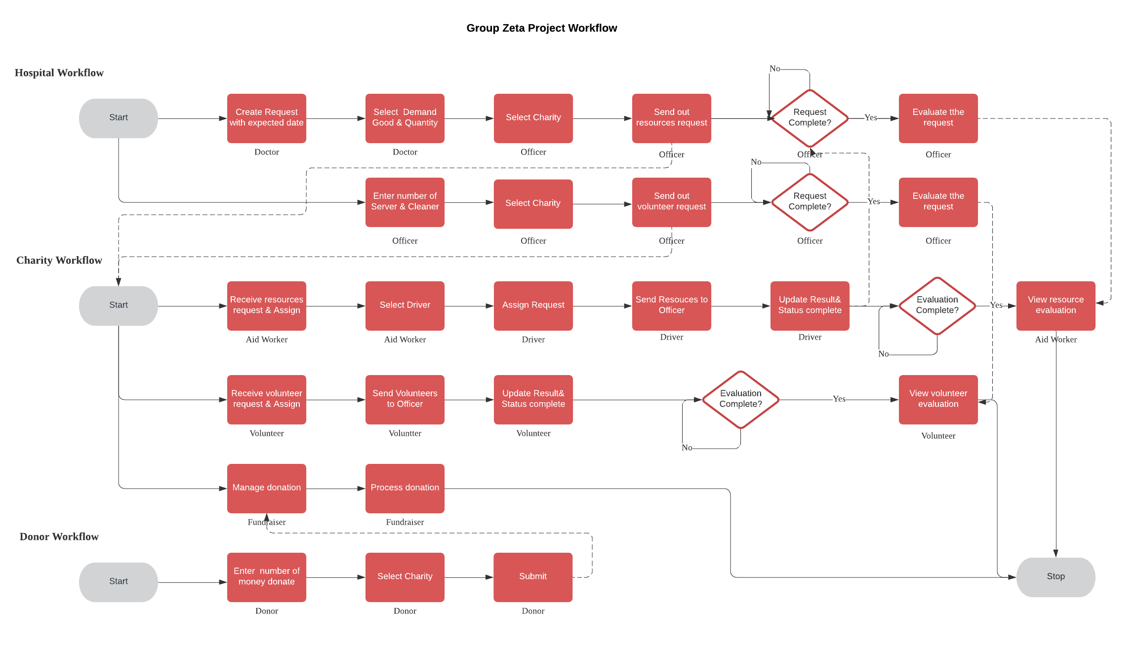
Workflow

Slide 11
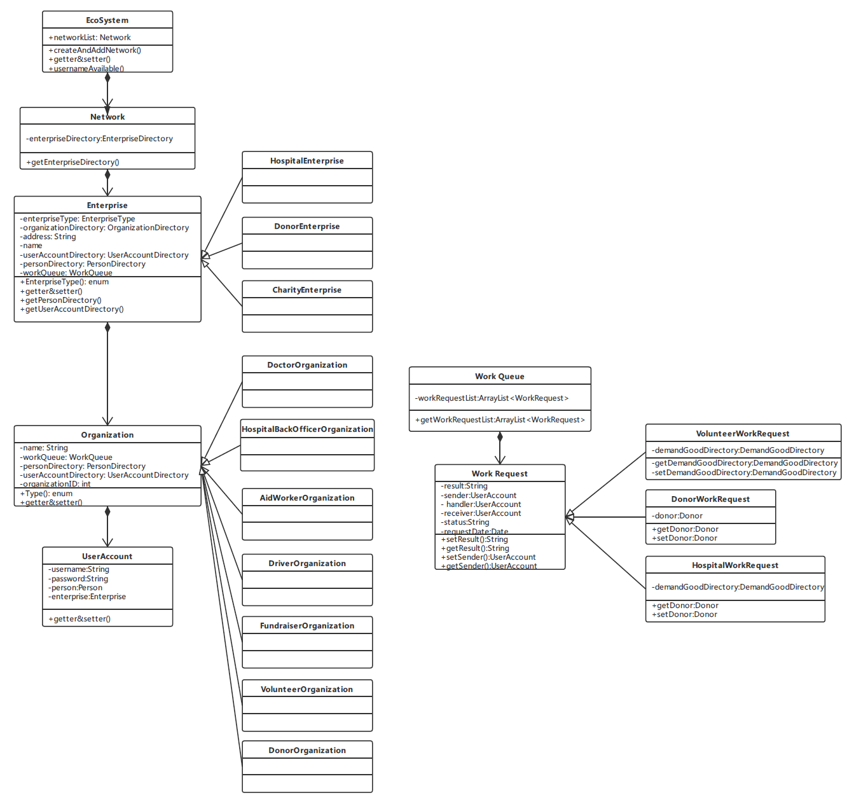
UML

Slide 12


Hospital Enterprise Roles:
Doctor(Doctor Office):
•Ask officer to start a resources order request with specific number and description.
•Ask officer to start a volunteer help request with specific number of cleaner and server.
Officer(Back Office):
•Place orders to get resources needed by doctor
•Receive resources from driver
•Give evaluations to volunteer department or aid worker department

Slide 13
Charity Roles:
Fundraiser
(Fundraiser Department):
•Receive fund from Donor.
Aid Admin Manager
(Aid Department):
•Receive order request from back office
•Send required resources to driver
Volunteer Admin Manager
(Volunteer Department):
•Receive order request from back office
•Send volunteers to officer
Driver(Transportation Department):
•Transit resources to back office

Slide 14

Donor Enterprise Roles:
Donor(Donor Organization):
•Donate money to charity foundation

Slide 15

Pokémon Network
Use case

Slide 16

Marvel Network
Use case

Slide 17
P
3
art
Key Screenshots

Slide 18
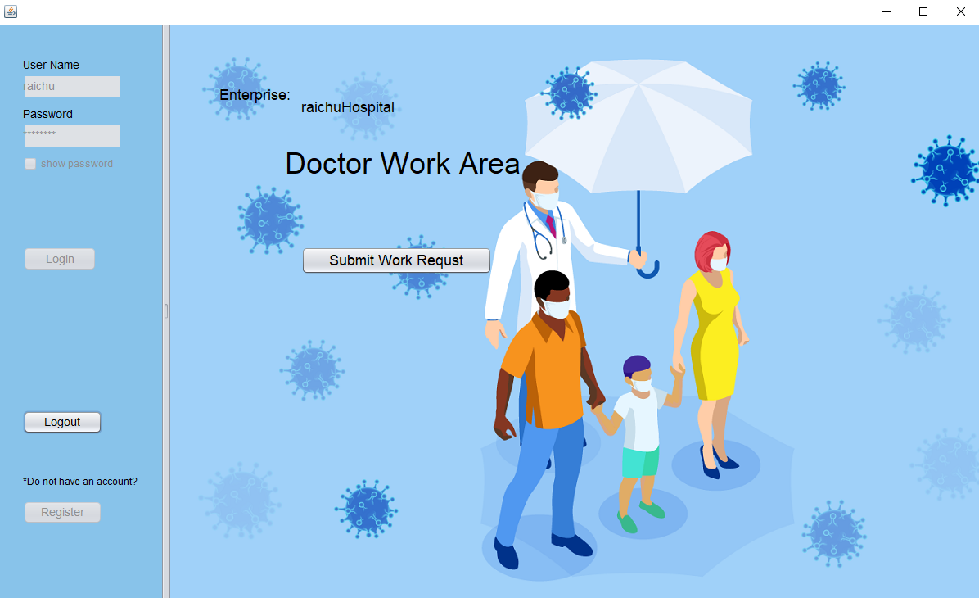
Key screenshot

Slide 19
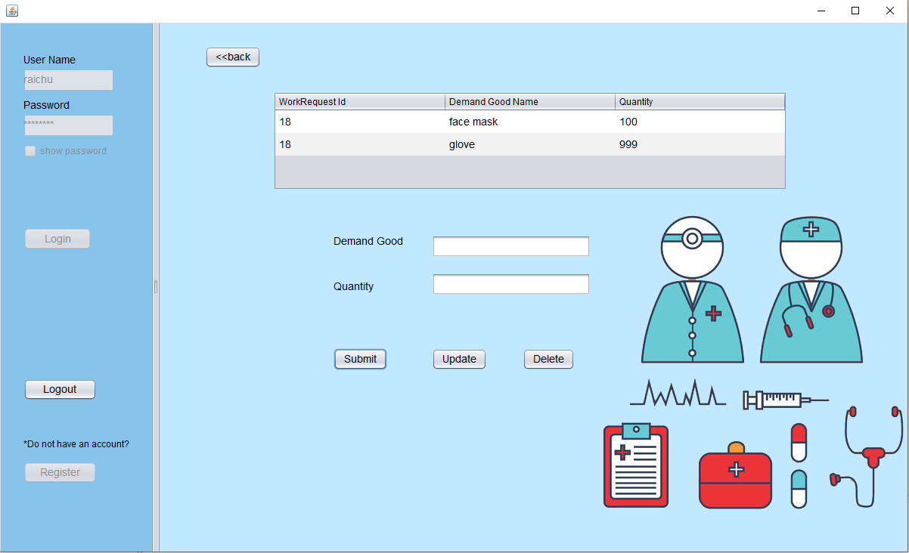
Key screenshot

Slide 20
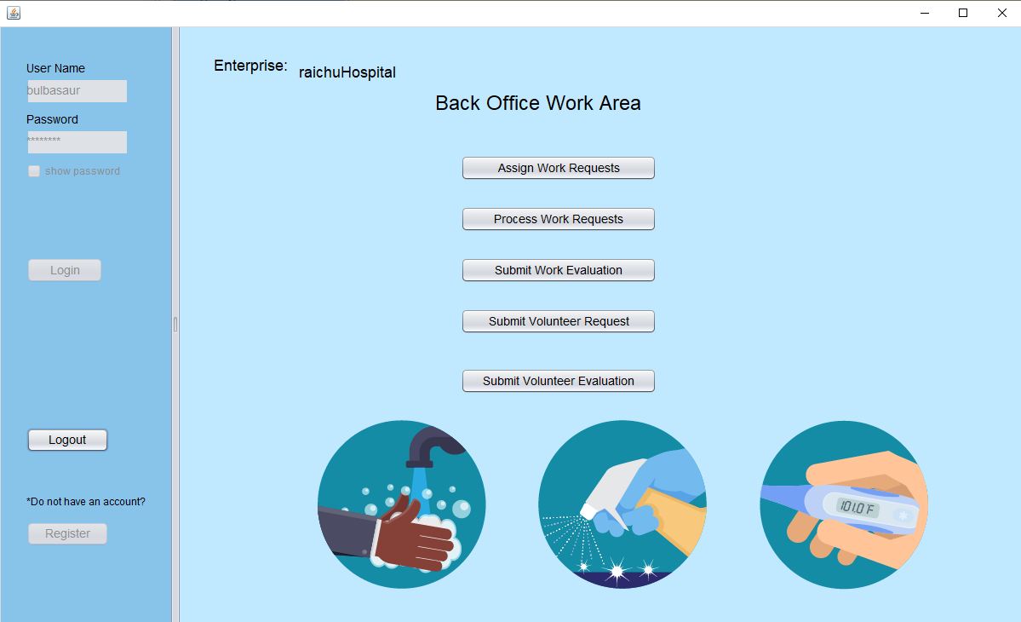
Key screenshot

Slide 21
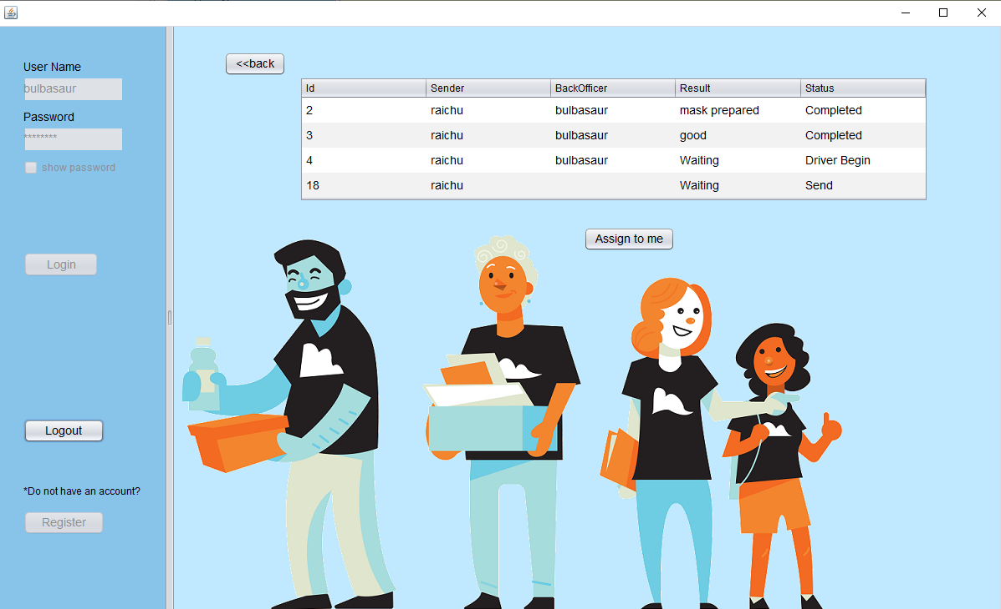
Key screenshot

Slide 22
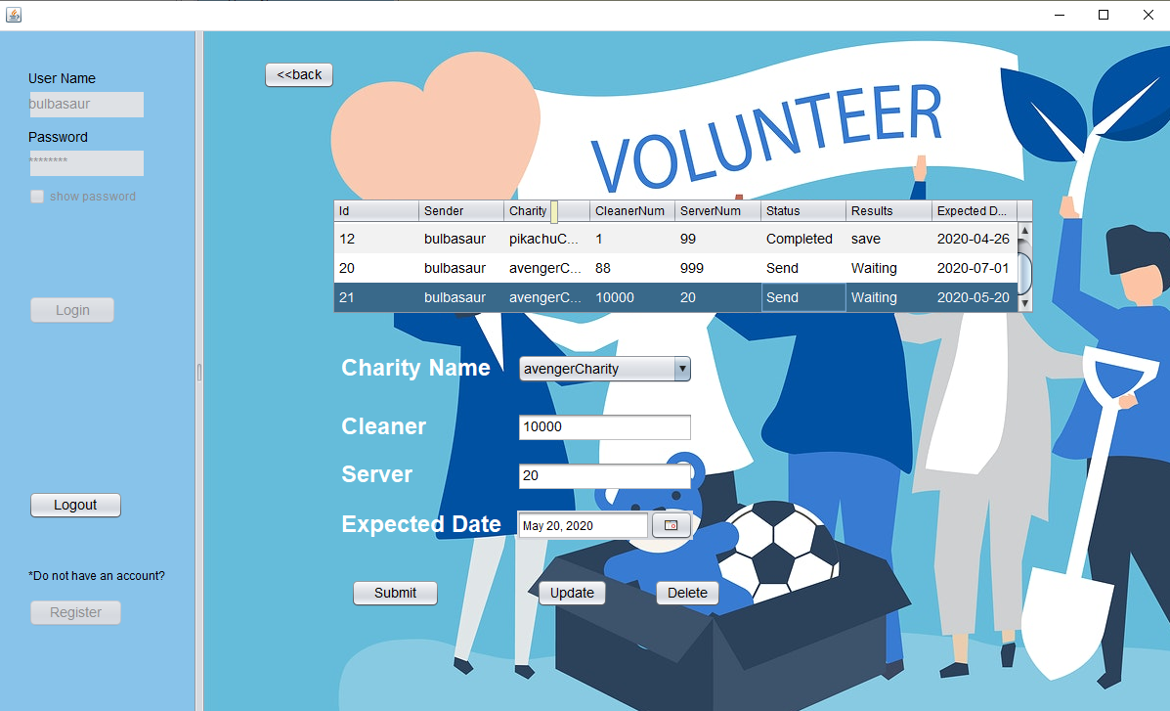
Key screenshot

Slide 23
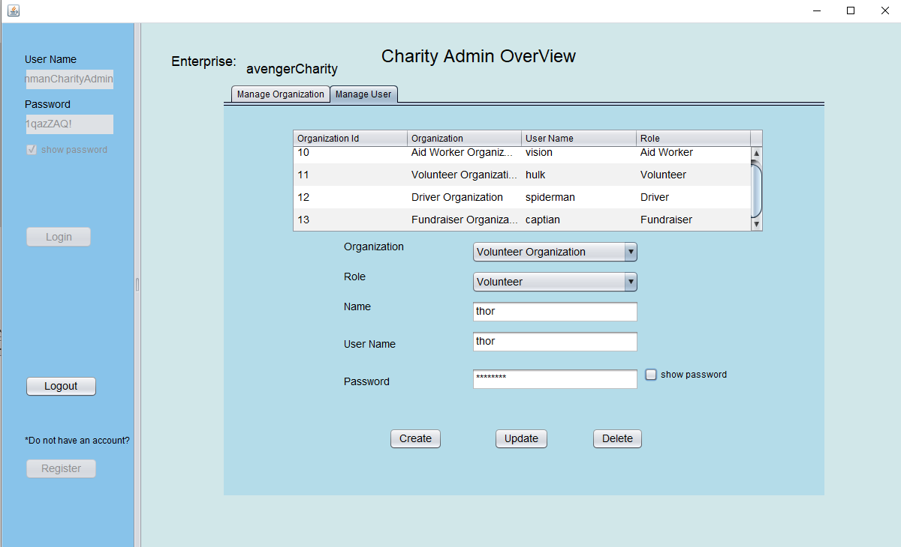
Key screenshot

Slide 24
Thank You
Group_Zeta

